Slide 1
Determining Movie Success by analyzing Tweet Sentiments
By: Sarvesh Shah
Parth Patel
Ajinkya Bobade
‹#›

Slide 2
Problem Statement
The purpose of this project is to determine if there’s a correlation between the sentiment towards the movie on Twitter and its eventual user rating on IMDB after its release.
Key Hypothesis: Movies with an IMDB user rating higher than 8 is expected to have an overall positive sentiment rating and good financial success.
Similarly, movies with a rating below 7 will have an overall negative sentiment and go into losses.
‹#›

Slide 3
Movie Selection
We picked 5 movies that released within the last few months:
Deadpool
Zootopia
The Jungle Book
Barbershop: The Next Cut
Captain America: Civil War
We chose the first 4 movies (that have already released) to first check if there’s actually a correlation, and we chose the last movie to predict its user rating based on the sentiment.
The challenge was to pick a relevant movie where we could get enough data for our tweet database
‹#›

Slide 4
NLTK
NLTK Library used to identify sentiments from tweets
Two sentiment files - Positive and Negative
These two files served as our sentiment dictionaries
Using scikit-learn
8 Algorithms to get the confidence
Average Accuracy: 66%
‹#›
Notes:
https://pythonprogramming.net/static/downloads/short_reviews/positive.txt
https://pythonprogramming.net/static/downloads/short_reviews/negative.txt

Slide 5
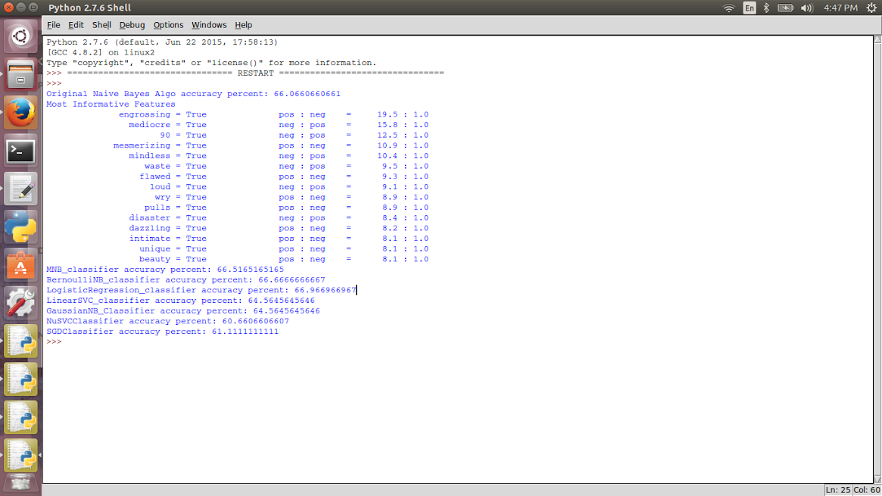
NLTK Continued
‹#›

Slide 6
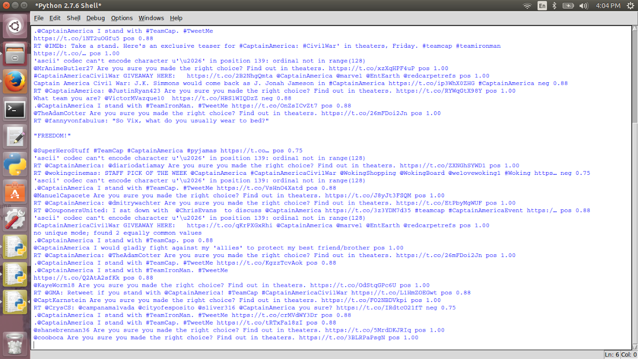
Database - Live Tweets
Using pickle files, live tweeting was done faster
This served as our database for tweets
‹#›

Slide 7
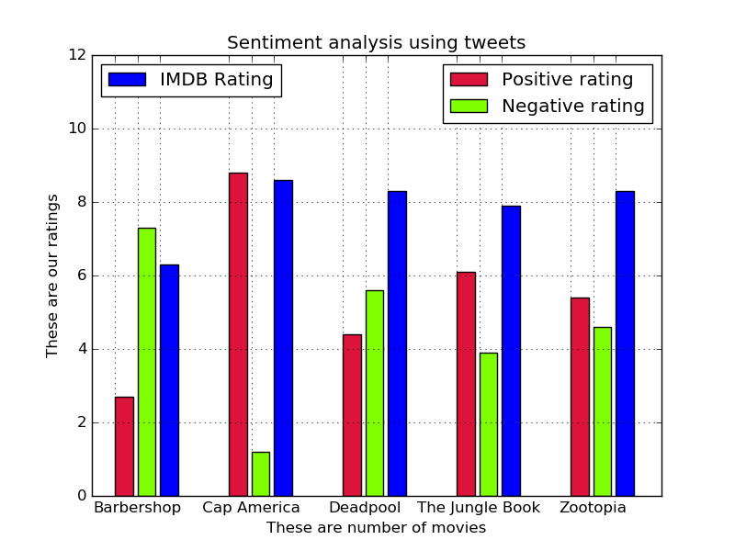
Graph
‹#›

Slide 8



Final Outcome
Movies (Sorted by their release date) | No. of Tweets Analyzed | Average Sentiment (Pos / Neg) | IMDB User Rating | Our Prediction Based on Sentiment | Was it a correct prediction? | Accuracy
Deadpool | 2000 | 4.4 / 5.6 | 8.3 | Unsuccessful | No -- Great online reviews and financial success
Zootopia | 1000 | 5.4 / 4.6 | 8.3 | Successful | Success!
The Jungle Book | 1900 | 6.1 / 3.9 | 7.9 | Successful | Success!
Barbershop: The Next Cut | 1500 | 2.7 / 7.3 | 6.3 | Unsuccessful | Somewhere in the middle! -- Bad online reviews but financial profits
Captain America: Civil War | 2200 | 8.8 / 1.2 | 8.6 (Critics Rating) | Successful | --- (This is probably going to be a hit!)
‹#›

Slide 9
References
http://scikit-learn.org/stable/tutorial/machine_learning_map/
https://pythonprogramming.net/naive-bayes-classifier-nltk-tutorial/
https://pythonprogramming.net/sklearn-scikit-learn-nltk-tutorial/
https://pythonprogramming.net/python-pickle-module-save-objects-serialization/
‹#›

